Slide 1
MUHAMMAD ALI

Slide 2
Hello everyone! My name is Muhammad Ali Shaheen. I am excited to share a little about myself, my journey, and what I’ve learned during this course. This presentation reflects who I am and where I aim to go in the future
Introduction :

Slide 3

Personality Traits: Honest and responsible Creative and imaginative Friendly and cooperative Confident and determined
Hobbies & Interests
In my free time, I like to:
Using Social Mediate
Watch films
I go to gym

Slide 4


Academic/Personal Achievements
Some of my proud achievements include:
Successfully completed my course with good grades and improved my overall academic performance.
Participated in class projects and group presentations, which helped me build confidence and teamwork skills.
Received positive feedback from teachers for my dedication, regular attendance, and active participation in class activities.
Skills Learned in This Course
During this course, I have gained many useful skills, such as:
Communication and presentation skills
Time management and teamwork
Basic understanding of digital tools and technologies
Problem-solving and critical thinking

Slide 5

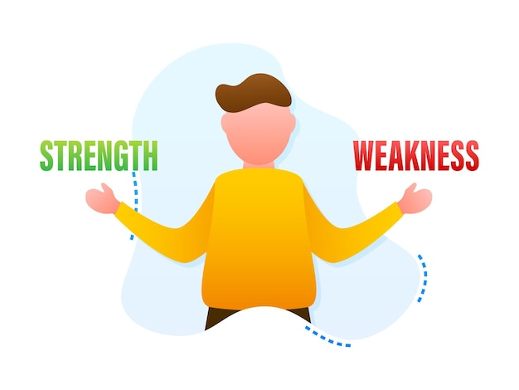
Favorite Topic/Tool
My favorite tool is Adobe Illustrator because it allows me to express my creativity and transform my ideas into professional designs. Illustrator is a powerful vector-based graphic design software that helps me create logos, posters, icons, illustrations, and other visual content with high precision and quality. One of the things I like most about Illustrator is that the designs I create can be scaled to any size without losing quality, which makes it perfect for both digital and print projects.
Strengths & Weaknesses
Strengths:
Strong problem-solving skills
Team player and cooperative
Good communication skills
Positive attitude
Adaptable to new situations
Weaknesses:
Need to Control Anger

Slide 6
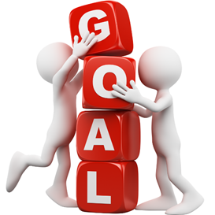
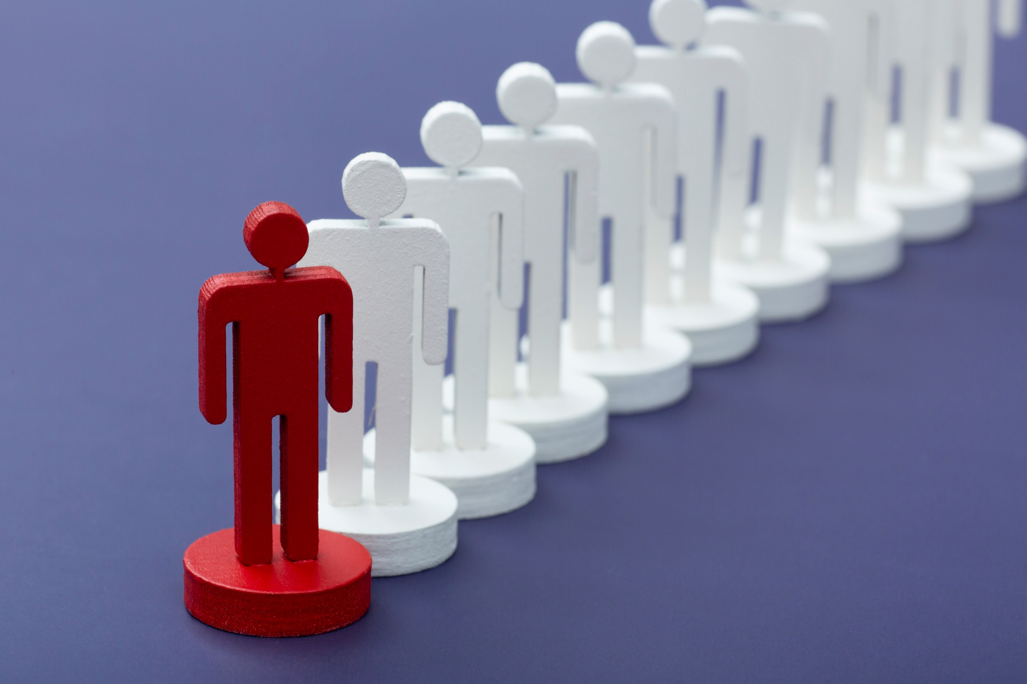
Future Goals
My future goals are:
To become a businessman
To build a successful career in AI Field
To contribute positively to society and make a difference
Role Model/Inspiration
My greatest role model and source of inspiration is Prophet Muhammad (peace be upon him). He was the perfect example of honesty, kindness, patience, and justice. His character teaches us how to live a meaningful and balanced life, treat others with respect, and always speak the truth. Despite facing many challenges, he never gave up and continued to spread the message of peace, love, and equality. I look up to him because his life motivates me to be a better person and to follow the path of goodness and compassion.

Slide 7
Slide Tite
Closing / Fun Fact
I love exploring new creative tools and learning something different each week. I believe that even a small skill can lead to big opportunities in the future
-THANKYOU-

